Slide 1
Linux Memory Management
組員: 934361 周志鴻
936703 黃珮琪

Slide 2
Outline
x86 Segmentation & Paging
Linux Memory Management
  Segmentation & Paging
  Page Frame Management
  Slab Allocator
  Non-contiguous Memory Area Management
  Process Address Space
  Page Fault Handler

Slide 3
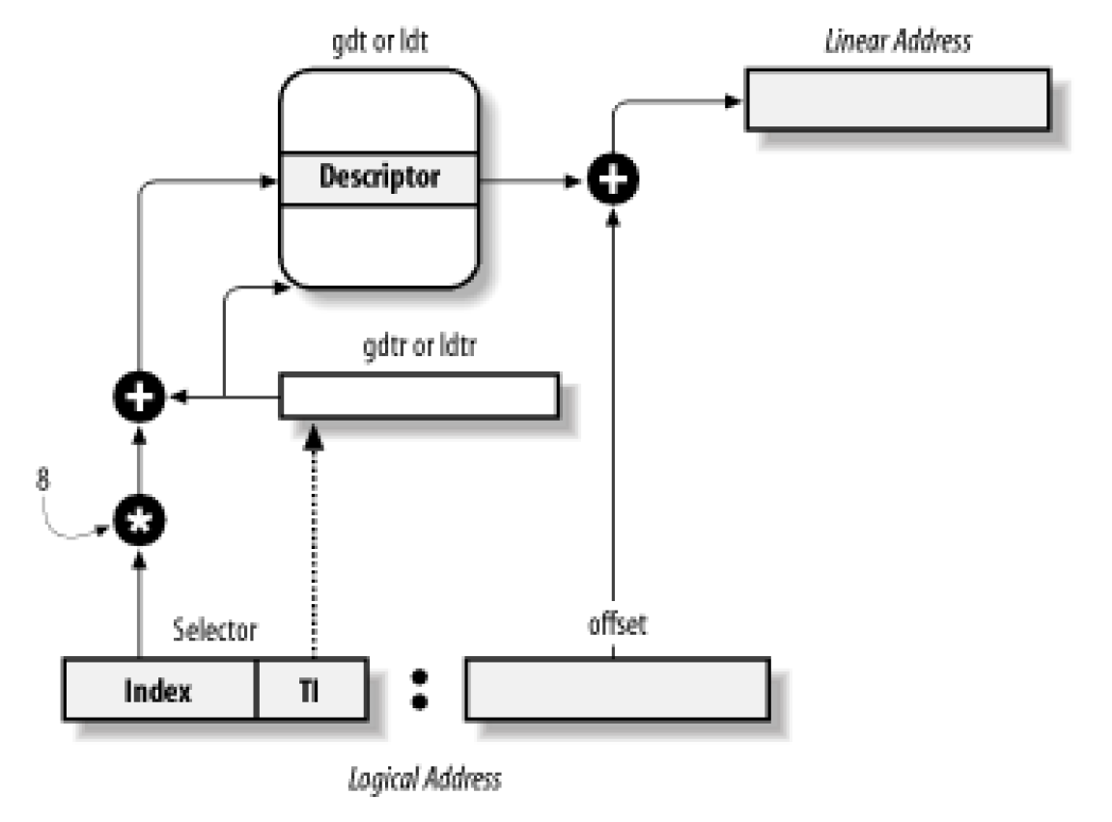
x86 Segmentation
GDT or LDT
Linear Address
GDTR or LDTR
8
15 3 2 1 0
31 0
Selector TI RPL
Offset
Table Indicator
Logical Address

Slide 4
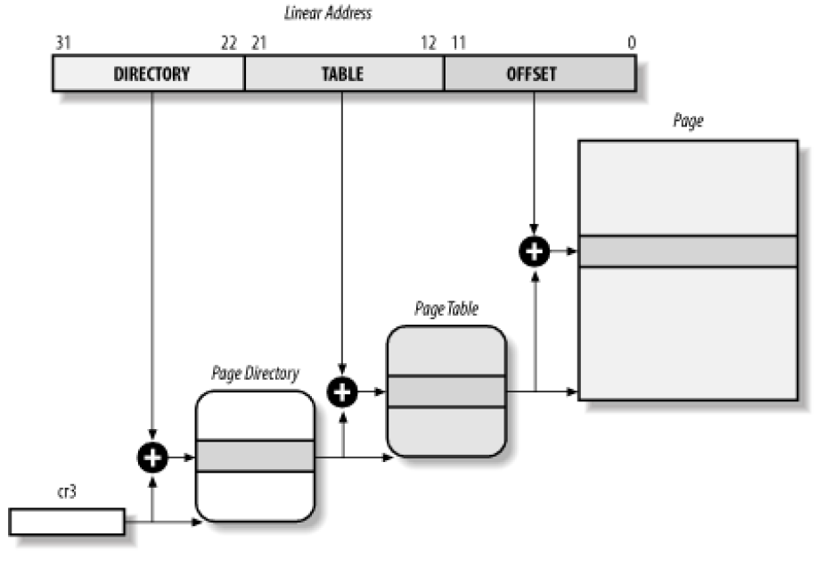
x86 Paging
Linear Address
Page
Physical Address
Page table
Page
directory
cr3

Slide 5
x86 Paging (2)
Page directory/table entry
31 12 7 6 5 2 1 0
P
S
U
/
S
R
/
W
Page Address
D
A
P
Page Size (Only page directory entry)
Dirty Flag
Access Flag
User / Supervisor
Read / Write
Present Flag

Slide 6
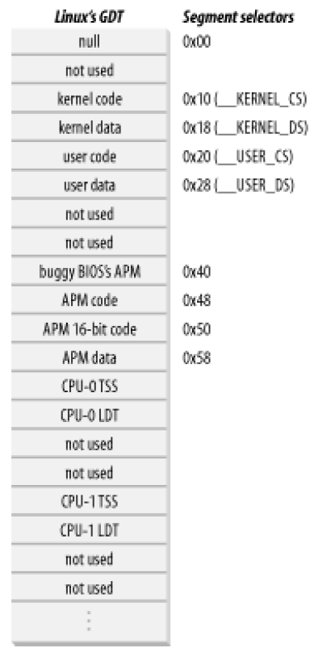
Segmentation in Linux
Segmentation are used in a limited way
All kernel and user segments overlap into 4GB
Use segment as identifier
  Kernel: RPL = 0
  User: RPL = 3

Slide 7
Paging in Linux
Linux use 3-level paging
  Adds page middle directory (PMD)
Apply on the x86 architecture
  Define the size of PMD as 1
  PMD translation is identical mapping
    Output of PMD translation
    = Input of PMD translation
    = Output of PGD translation
Notes:
3-level paging: easy to apply to 64bit cpu

Slide 8
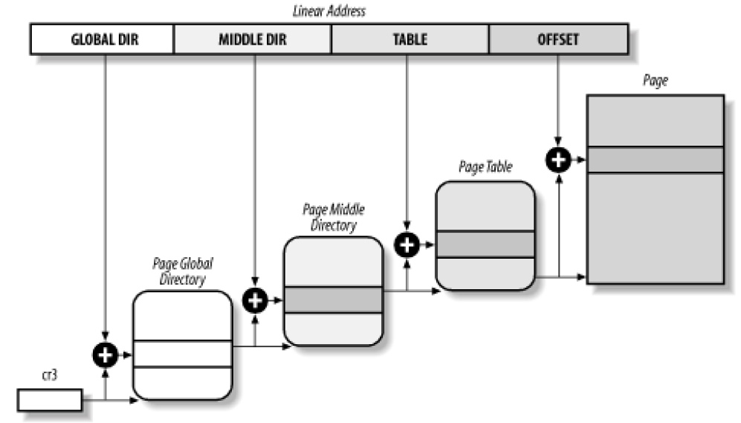
Paging in Linux (2)
Linear Address
Page
Page
middle
directory
Page table
Physical Address
Page
global
directory
cr3
Notes:
cr3: register that stores the page global descriptor table which can help us to find the linear -> physical translation
Every context switch will change the cr3 register to the corresponding process

Slide 9
Paging in Linux (3)
pgd_t, pmd_t, pgd_t are 32-bit data types
(unsigned long) for entries
The functions and macros for creating and
manipulating entries are defined in
  include/asm-i386/page.h
  include/asm-i386/pgtable.h
  include/asm-i386/pgtable-2level.h
  include/asm-i386/pgtable-3level.h
  include/asm-i386/pgalloc.h
  include/asm-i386/pgalloc-2level.h
  include/asm-i386/pgalloc-3level.h
  include/linux/mm.h
Page Address
Extension (PAE)
Notes:
Page table/directory entry handle, create, delete.

Slide 10
Linux Memory Mapping (x86)
Reserved for memory mapped IO & Non-contiguous memory area allocation
4 GB
HIGH_MEM
Anywhere
Physical
Memory
4 GB
3GB + 896 MB
Kernel
Space
3 GB
PAGE_OFFSET
TASK_SIZE
User
Space
896MB
Anywhere
0 GB
0 GB
Notes:
High memory page table.. Check it out… !!!
Under x86

Slide 11
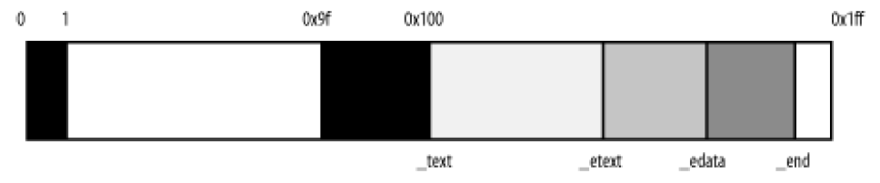
Linux Kernel Image (x86)
1 MB
2 MB
Kernel Code
Data
BSS
_text
_etext
_edata
_end
BIOS
Video RAM Mapping
Physical Address
Notes:
Bootloader loads kernel image
Compile time information

Slide 12
Overview
Linear Address Space
Process
Address
Space
Slab
Allocator
Noncontiguous
Memory
Management
Page
Fault
Handler
User Space
Kernel Space
Physical Memory
Allocate
Pages
NUMA
Buddy
System
Zone
Page
Page

Slide 13
Linear Address Space
Process
Address
Space
Slab
Allocator
Noncontiguous
Memory
Management
Page
Fault
Handler
User Space
Kernel Space
Physical Memory
Allocate
Pages
NUMA
Buddy
System
Zone
Page
Page

Slide 14
Page Descriptor
The kernel keeps track of the current status of each page frame
The struct page is the descriptor of each frame
All the page frame descriptors on the system are included in an array called mem_map (#if !NUMA)
Notes:
在沒 NUMA 的情況下, mem_map 這個 variable 才會被定義(用 macro 包起來.. 所以會消失)
如果是 NUMA 的話則是所有的 noda 都有自己的 node_mem_map (make sense huh!)

Slide 15
Page Descriptor
/include/linux/mm.h
struct page
{
unsigned long flags;
atomic_t count;
struct list_head list;
…
unsigned long index;
struct list_head lru;
union {
struct pte_chain *chain;
pte_addr_t direct;
} pte;
unsigned long private;
void *virtual;
};
Status of page frame
Usage Count
Page out list
PTE chain for swapping
Notes:
Present rmap here?
Usage Count: 0 -> free the page

Slide 16
Page Flags
/include/linux/page-flags.h
#define PG_locked 0 /* Page is locked. Don't touch. */
#define PG_error 1
#define PG_referenced 2
#define PG_uptodate 3
#define PG_dirty 4
#define PG_lru 5
#define PG_active 6
#define PG_slab 7
#define PG_highmem 8
#define PG_checked 9 /* kill me in 2.5.<early>. */
…
#define PG_reclaim 18 /* To be reclaimed asap */
#define PG_compound 19
Notes:
Delete?

Slide 17
NUMA & Memory Zone
NUMA (Non-Uniform Memory Access)
  Access time of different memory may vary
  Physical memory is partitioned into several nodes
Memory zones
  Nodes are subdivided into zones
  ZONE_ DMA < 16MB
  ZONE_ NORMAL 16MB ~ 896MB
  ZONE_ HIGHMEM > 896 MB
Notes:
DMA with 16 MB for ISA related access
>896 reserved for noncotiguous memory allocation and fix-mapped linear address
NUMA for power management? ☺

Slide 18
Zone Descriptor
/include/linux/mmzone.h
struct zone
{
unsigned long free_pages;
unsigned long pages_min, pages_low, pages_high;
…
spinlock_t lru_lock;
struct list_head active_list;
struct list_head inactive_list;
…
unsigned long nr_active;
unsigned long nr_inactive;
struct free_area free_area[MAX_ORDER];
…
struct pglist_data *zone_pgdat;
struct page *zone_mem_map;
unsigned long zone_start_pfn;
char *name;
…
}
Swap
Buddy System
F

Slide 19
Node Descriptor
/include/linux/mmzone.h
typedef struct pglist_data
{
struct zone node_zones[MAX_NR_ZONES];
struct zonelist node_zonelists[MAX_NR_ZONES];
int nr_zones;
struct page *node_mem_map;
unsigned long *valid_addr_bitmap;
struct bootmem_data *bdata;
unsigned long node_start_pfn;
…
struct pglist_data *pgdat_next;
…
} pg_data_t;
Zone Lists
Array of page descriptors
Node Lists
Notes:
Present pages: # of pages in the node
Spanned_pages: total size of node

Slide 20
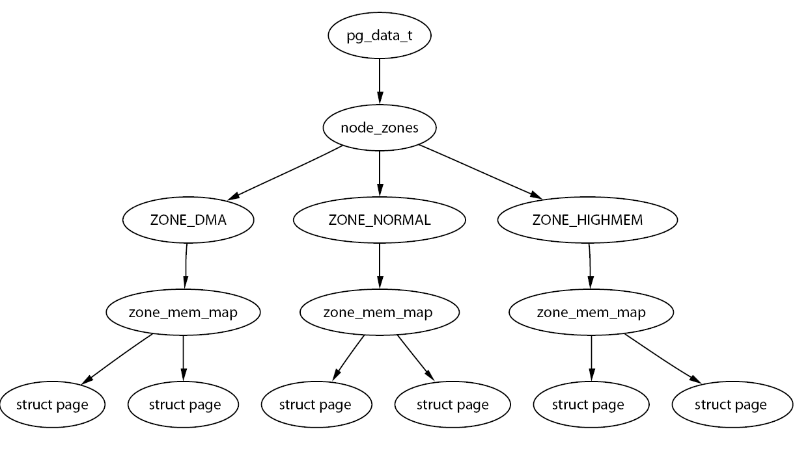
Relationship between Node, Zone & Page Descriptor
Node Descriptors
Zone Descriptors
Page Descriptors
Notes:
Under x86 architecture, linux only uses one node, which span all the physical memory (mem_map = node_mem_map)

Slide 21
Linear Address Space
Process
Address
Space
Slab
Allocator
Noncontiguous
Memory
Management
Page
Fault
Handler
User Space
Kernel Space
Physical Memory
Allocate
Pages
NUMA
Buddy
System
Zone
Page
Page

Slide 22
Buddy System
Low level page allocation
Deal with External fragmentation
Efficient strategy for allocating groups of contiguous page frames
Allocates memory from one of a set of disjoint zones
Notes:
The most important component of linux memory management.
Buddy system manages all the physical memory in the system.
Any component who want memory will eventually ends in buddy system.

Slide 23
Buddy System (2)
Buddy algorithm
  Allocation
    Allocates 2^n pages
    If the block of pages found is larger than requested must be broken down until there is a block of the right size
  Deallocation
    Recombine pages into large blocks of free pages whenever it can
    Whenever a block of pages is freed, the adjacent or buddy block of the same size is checked to see if it is free

Slide 24
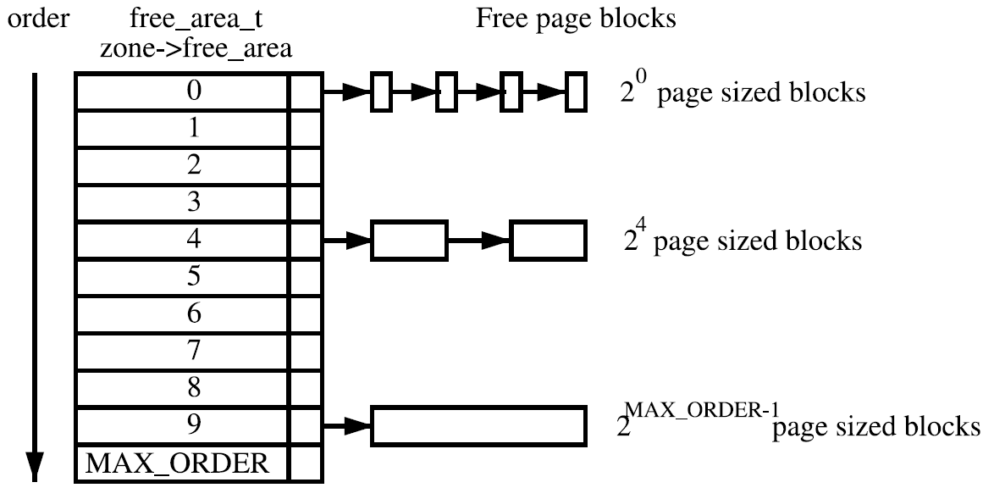
Buddy System (3)
struct free_area
{
struct list_head free_list;
unsigned long *map;
};
Free page descriptor list
0, Both busy or free
1, One of buddy is busy
Z
Notes:
2.6 MAX_ORDER = 11, perhaps bcz of memory is cheaper than before…

Slide 25
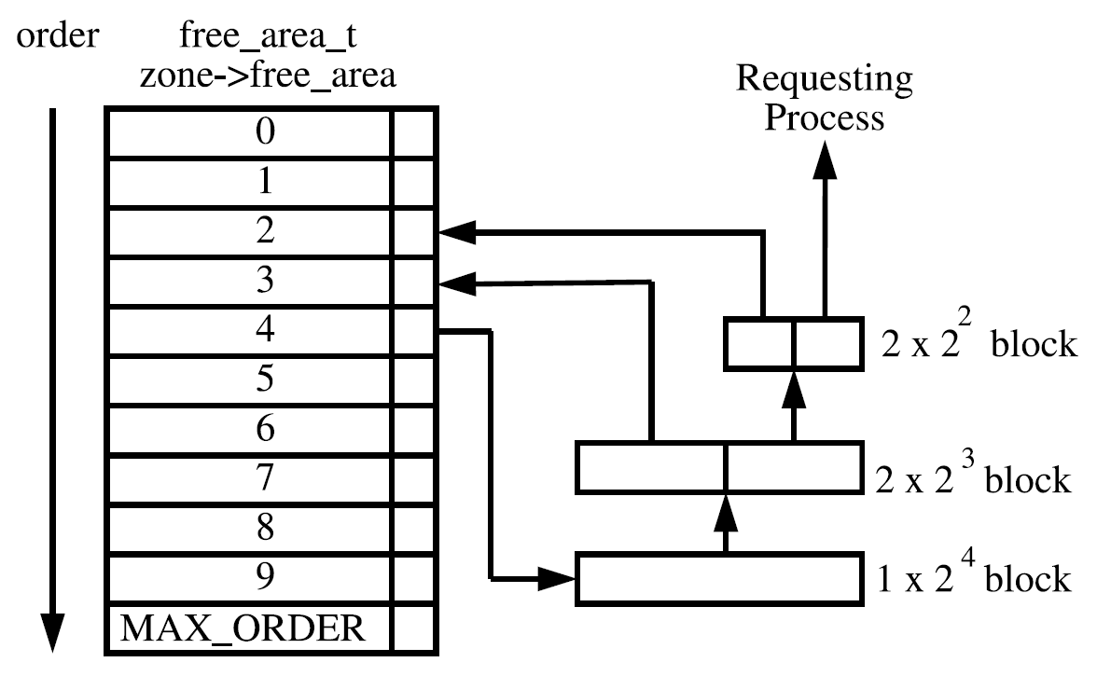
Buddy System (4)
Example

Slide 26
alloc_pages (/mm/page_alloc.c)
__alloc_pages(gfp_mask, order, zonelist)
alloc_pages
order: 2^order pages
zonelist: from which NODE
gfp_mask: get pages from DMA, NORMAL or HIGHMEM region
__alloc_pages
buffered_rmqueue
wakeup_kswapd
try_to_free_pages
Notes:
Call buffered_rmqueue() to get free pages
If there has no enough free pages, call wakeup_kswapd() to swap out pages and try again
2.6: order = 0, allocate from per_cpu_pages
Go through four times
(1) take min into account
→ wake up kswapd
(2) take HIGHMEM into account
(3) ignore min
→ try_to_free_pages
(4) try once more

Slide 27
free_pages (/mm/page_alloc.c)
__free_pages_ok(page, order)
  If possible, it merges the freed region with its buddy, then merges that larger region with its buddy, and so on
Notes:
改?

Slide 28
Linear Address Space
Process
Address
Space
Slab
Allocator
Noncontiguous
Memory
Management
Page
Fault
Handler
User Space
Kernel Space
Physical Memory
Allocate
Pages
NUMA
Buddy
System
Zone
Page
Page

Slide 29
Slab Allocator
Kernel provides two separate pairs of malloc- and free-like functions
  kmalloc and kfree
  vmalloc and vfree (latter section)
kmalloc is implemented by the slab allocator algorithm

Slide 30
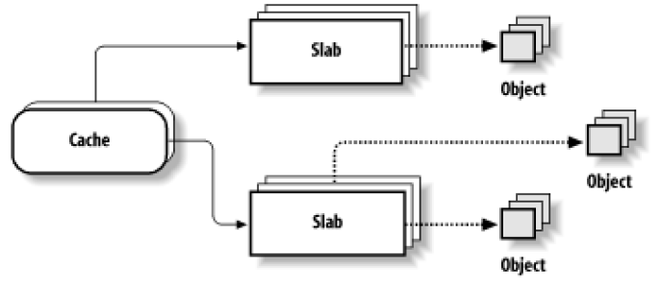
Slab Characteristics
Reduces “Internal fragmentation” by allocating “objects”
Build on top of the Buddy System
Each cache is a “store” of objects of the same type
All objects allocated from a given slab cache have the same size, commonly 2^N bytes
Notes:
What about small size data structure? -> slab

Slide 31
Cache Descriptor
/mm/slab.c
struct kmem_cache_s
{
struct array_cache *array[NR_CPUS];
struct kmem_list3 lists;
unsigned int objsize;
unsigned int flags;
…
unsigned int gfporder;
unsigned int gfpflags;
void (*ctor)(void *, kmem_cache_t *, unsigned long);
void (*dtor)(void *, kmem_cache_t *, unsigned long);
const char *name;
struct list_head next;
};
Per-CPU slab cache
struct list_head slabs_partial
struct list_head slabs_full
struct list_head slabs_free
Parameters passed to the Buddy system
Constructor
De-constructor
Notes:
gfp: get free page

Slide 32
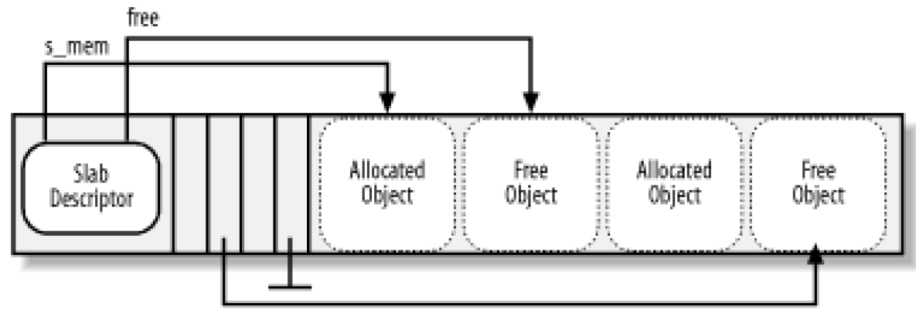
Slab Descriptor
/mm/slab.c
struct slab {
struct list_head list;
unsigned long colouroff;
void * s_mem;
unsigned int inuse;
kmem_bufctl_t free;
};
Pointer of first object in the slab
# of allocated objects
Index of first free object
Free object index

Slide 33
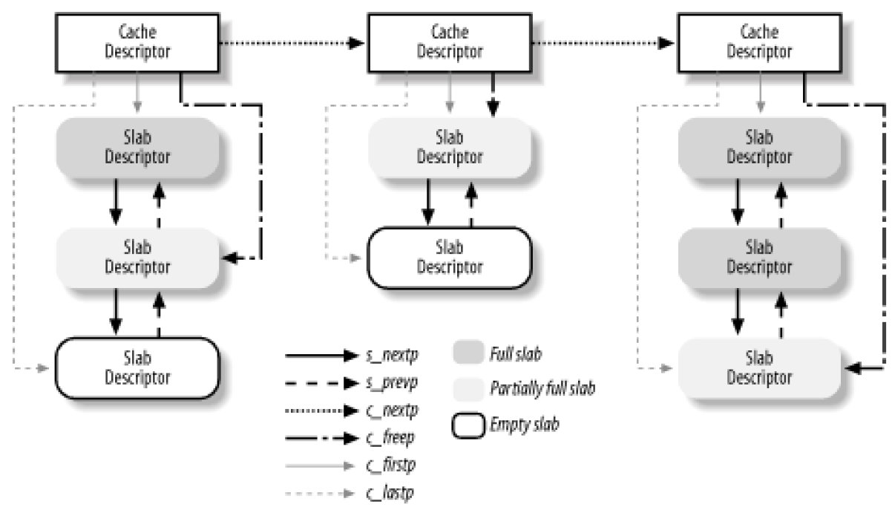
Relationship

Slide 34
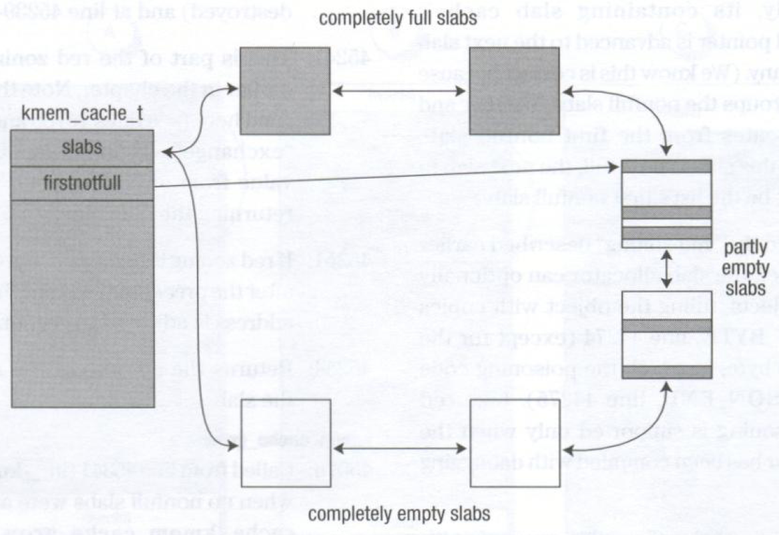
Slab Algorithm

Slide 35
Type of Slab
General cache: kmem_cache_init()
  cache_cache: cache of “cache descriptor”
  cache_sizes
    struct cache_sizes {
    size_t cs_size;
    kmem_cache_t *cs_cachep;
    kmem_cache_t *cs_dmacachep;
    };
  malloc_sizes: array of predefined cache_sizes
  (32B ~ 128MB)
Specific cache: kmem_cache_create()
  Used by the kernel
  Ex: kmem_cache_t *vm_area_cachep;
  kmem_cache_t *mm_cachep;
Notes:
kmem_cache_init : call when kernel initialization
Specific caches are also initialized when kernel initialization

Slide 36
Per Cpu Cache
Each cache contains a small array of freed objects for each CPU
Purpose
  Reduce the number of linked list operations
  Reduce spinlock contention
struct array_cache {
unsigned int avail;
unsigned int limit;
unsigned int batchcount;
…
};
avail
limit
desc
obj
obj

Slide 37
kmalloc()
kmem_cache_alloc()
kfree()
kmem_cache_free()
1
1
Slab Allocator
2
8
ac_data(), ac_entry()
2
Timer
descriptor
1
cache_reap()
→drain_array()
cache_refill()
3
7
avail
2
cache
slab_full
→slab_destroy()
slab_partial
object
slab_free
→kmem_free_pages()
4
9
3
cache_grow()
→ kmem_getpages()
Buddy System
5
__alloc_pages()
4
__free_pages_ok()
Page(s)
Page(s)
Notes:
ac_data: get corresponding array_cache
ac_entry: manipulation

Slide 38
Linear Address Space
Process
Address
Space
Slab
Allocator
Noncontiguous
Memory
Management
Page
Fault
Handler
User Space
Kernel Space
Physical Memory
Allocate
Pages
NUMA
Buddy
System
Zone
Page
Page

Slide 39
Noncontiguous Memory Area Management
For infrequent memory requests sometimes it makes sense to allocate noncontiguous memory areas
  Works similarly as paging
  Uses the reserved addresses above PAGE_OFFSET to map noncontiguous memory areas
  To allocate and release noncontiguous memory, use vmalloc and vfree, respectively
  Ex: modules, I/O driver buffers

Slide 40
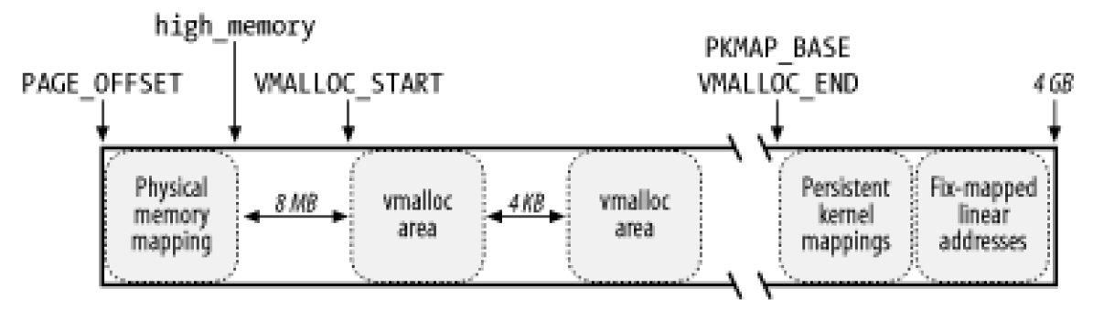
Linear Address Interval
Starting address of kernel page table entry
End of physical memory
HIGH_MEM
3 GB
VMALLOC_OFFSET
Safety interval
Safety interval
Memory mapped I/O address

Slide 41
VM Descriptor
struct vm_struct {
void *addr;
unsigned long size;
unsigned long flags;
struct page **pages;
unsigned int nr_pages;
unsigned long phys_addr;
struct vm_struct *next;
};
Start linear address
Memory size
Page descriptors array
# of page
Physical address (IO-remap)
VM List
Notes:
Green, new in 2.6

Slide 42
Search Free VM Area
get_vm_area(addr, flag)
  First-fit algorithm
vmlist
addr
addr+size
VMALLOC_START
VMALLOC_END
：Allocated space
：Unallocated space

Slide 43
vmalloc (/mm/vmalloc.c)
P
(vmalloc → __vmalloc)
void *__vmalloc(unsigned long size, int gfp_mask, pgprot_t prot)
{
struct vm_struct *area;
struct page **pages;
...
area = get_vm_area(size, VM_ALLOC);
...
area->pages = pages = kmalloc(array_size, “gfp_flags”);
...
for (i = 0; i < area->nr_pages; i++) {
area->pages[i] = alloc_page(gfp_mask);
...
}
if (map_vm_area(area, prot, &pages))
goto fail;
return area->addr;
…
}
Get free address space
Allocate page descriptors from Slab
Allocate page one by one from Buddy system
Allocate corresponding page directory/table entries to Kernel Page Table (init_mm)

Slide 44
vfree (/mm/vmalloc.c)
(vfree → __vunmap)
void __vunmap(void *addr, int deallocate_pages)
{
struct vm_struct *area;
area = remove_vm_area(addr);
…
if (deallocate_pages) {
int i;
for (i = 0; i < area->nr_pages; i++) {
…
__free_page(area->pages[i]);
…
kfree(area->pages);
}
kfree(area);
return;
}
Free kernel virtual memory space
Free pages to Buddy System
Free page descriptors
Free vm_struct

Slide 45
Linear Address Space
Process
Address
Space
Slab
Allocator
Noncontiguous
Memory
Management
Page
Fault
Handler
User Space
Kernel Space
Physical Memory
Allocate
Pages
NUMA
Buddy
System
Zone
Page
Page

Slide 46
Process Address Space
The address space of a process consists of all logical addresses that the process is allowed to use
  Each process address space is separate
  The kernel allocates logical addresses to a process in intervals called memory regions
When a process gets new memory regions?
  Creating a new process: fork()
  Loading an entirely new program: execve()
  Memory mapping a file: mmap()
  Growing its stack
  … etc

Slide 47
Process Address Space (2)
To the kernel, user mode requests for memory are
  Considered non-urgent
  Considered untrustworthy
As a result, the kernel tries to defer allocation of dynamic memory to processes
Notes:
Considered non-urgent
Unlikely to references all of its pages
Allocated memory may not be accessed for a while
Considered untrustworthy
Kernel must be prepared to catch all addressing errors

Slide 48
Memory Region Descriptor
Linux represents a memory region with vm_area_struct (VMA)
Memory regions never overlap
Kernel tries to merge contiguous regions
All regions are maintained on a simple list in ascending order by address
  If the list of regions gets large, then it is also managed as an red-black tree for efficiency

Slide 49
vm_area_struct (/include/linux/mm.h)
struct vm_area_struct {
struct mm_struct * vm_mm;
unsigned long vm_start;
unsigned long vm_end;
…
struct vm_area_struct *vm_next;
pgprot_t vm_page_prot;
unsigned long vm_flags;
struct rb_node vm_rb;
…
struct vm_operations_struct * vm_ops;
};
The address space we belong to
Starting/Ending address of virtual memory
Next vm_area_struct
Access permission of the pages/VMA
Red-Black tree node
Function pointers invoked when the VMA is added, removed and when file is mapped to the VMA

Slide 50
Process Memory Descriptor
All information related to the process address space is included in the memory descriptor (mm_struct) referenced by the mm field of the process descriptor
  Page table
  # of allocated pages
  … etc
mm_struct is defined in task_struct named mm

Slide 51
mm_struct (/include/linux/sched.h)
struct mm_struct {
struct vm_area_struct * mmap;
struct rb_root mm_rb;
struct vm_area_struct * mmap_cache;
pgd_t * pgd;
atomic_t mm_users;
atomic_t mm_count;
…
struct list_head mmlist;
unsigned long start_code, end_code, start_data, end_data;
unsigned long start_brk, brk, start_stack;
unsigned long rss, total_vm, locked_vm;
…
};
VMA list
Red-Black Tree of memory regions
Last accessed VMA
# of LW process
Refernce of the mm_struct
mm_struct list
Heap, Stack address
Notes:
mm_count : kernel thread borrowing… +1 to prevent that all LW process die

Slide 52
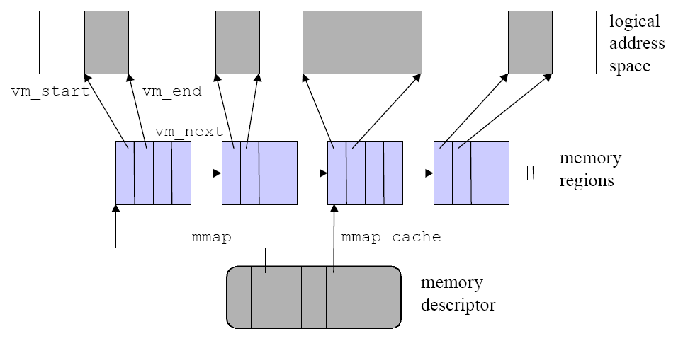
Address Space of a Process
0
3GB
Page aligned
vm_struct
mm_struct

Slide 53
do_mmap (/mm/mmap.c)
To allocate a logical address interval, the kernel uses do_mmap()
  Checks for errors and limits
  Tries to find an unmapped logical address interval in memory region list
  Allocates a vm_area_struct for new interval
  Updates bookkeeping and inserts into list (merging if possible)

Slide 54
do_munmap (/mm/mmap.c)
To release a logical address interval, the kernel uses do_munmap()
  Locates memory region that overlaps, since it may have been merged
  Removes memory region, splitting if necessary
  Updates bookkeeping

Slide 55
Linear Address Space
Process
Address
Space
Slab
Allocator
Noncontiguous
Memory
Management
Page
Fault
Handler
User Space
Kernel Space
Physical Memory
Allocate
Pages
NUMA
Buddy
System
Zone
Page
Page

Slide 56
Page Fault Handler
When a process requests more memory from the kernel, it only gets additional logical address space, not physical memory
When a process tries to access its new logical address space, a page fault occurs to tell the kernel that the memory is actually needed
(i.e., Demand paging)
Notes:
The page fault handler compares the logical address to the memory regions owned by the process to determine whether
The memory access was an error
Physical memory needs to be allocated to the process
An address may also not be in physical memory if the kernel has swapped the memory out to disk

Slide 57
Page Fault Handler (2)
Architecture-Dependent
  Get information about:
    What’s the problem?
    Where’s the offending address?
  Handles the “abnormal case” and vmalloc fault
  do_page_fault() (/arch/i386/mm/fault.c)
Architecture-Independent
  Handles the “normal case” for user
    Do COW, Demand paging, etc.
  handle_mm_fault() (mm/memory.c)
V

Slide 58
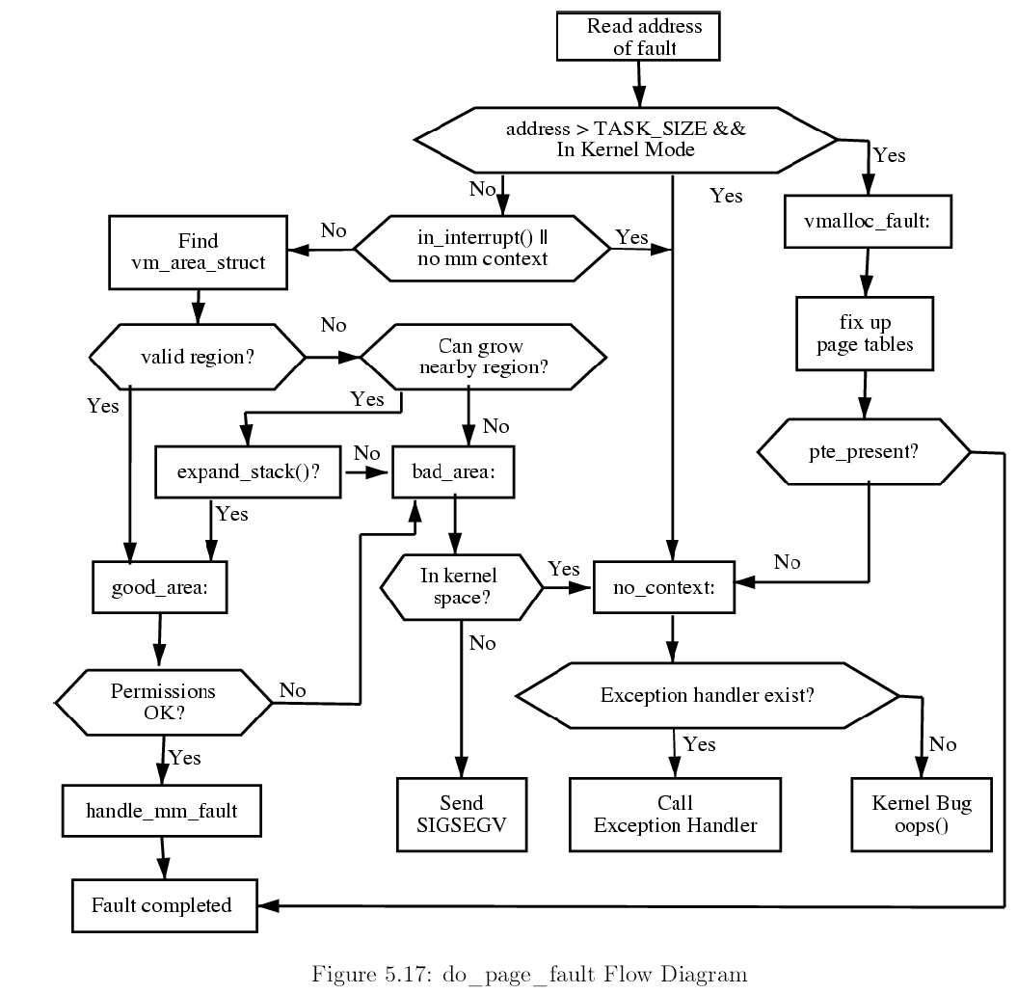
do_page_fault()
vmalloc fault
Architecture
independent
specific
Error condition
Notes:
Get address from cr2 register
vmalloc_fault: bcz noncontiguous memory area’s page table entries only allocated in master kernel page table (init_mm.pgd)
so when other process or kernel thread try to access this region. Kernel has to update the corresponding entries.X

Slide 59
handle_mm_fault (/mm/memory.c)
Demand paging
  Anonymous pages
  Device/file backed pages
Swapping
Copy On Write
  How to recognize a page as COW?
    PTE is write protected
    VMA is writable

Slide 60
handle_mm_fault
Check if page table
entry present
pte_alloc_map
handle_pte_fault
Allocate page table
PTE write protected
do_no_page
do_swap_page
do_wp_page
Demand paging
Swap in
Copy on wirte
!vma->vm_ops->nopage
do_anonymous_page
Expand stack

Slide 61
Review
Linear Address Space
Process
Address
Space
Slab
Allocator
Noncontiguous
Memory
Management
Page
Fault
Handler
User Space
Kernel Space
Physical Memory
Allocate
Pages
NUMA
Buddy
System
Zone
Page
Page

Slide 62
References
Linux Cross-Reference http://lxr.linux.no
O’Reilly – Understanding the Linux Kernel 2nd
Understanding the Linux Virtual Memory Manager
Jun-Chiao Wang - VM Architecture
I-Jui Sung - The Page Fault Handler in Linux: A Dynamic View for MM

Slide 63
Reverse Map
VM A
Page
Frame
VM B
RMAP
PTE Chain
VM C
Avoid searching all virtual address space
Notes:
Advantages of reverse mappings
Easy to unmap page from all address spaces
Page replacement scans based on physical pages
Less CPU spent inside memory manager
Less fragile behaviour under extreme load
Challenges with reverse mappings
Overhead to set up rmap structures
Out of memory while allocating rmap?

